Slide 1
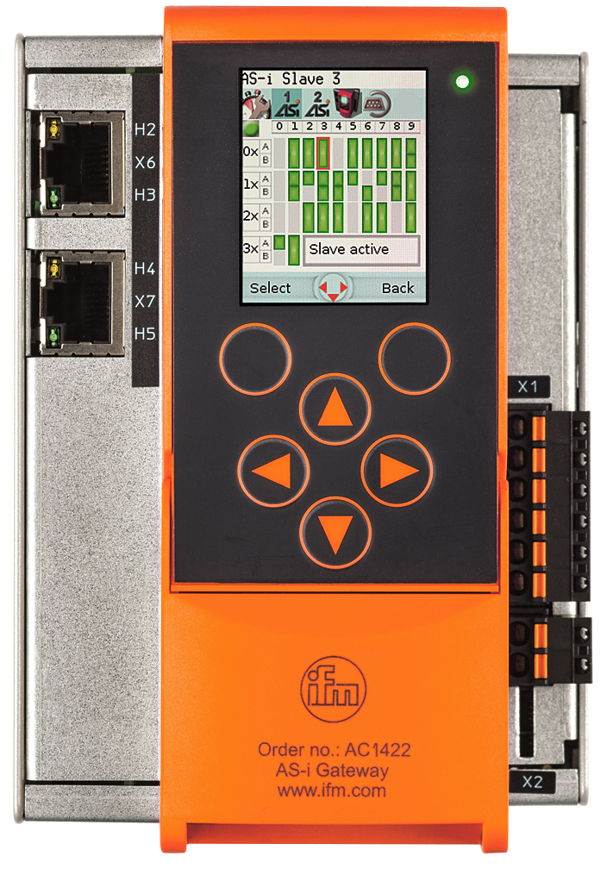
AL1x4x Setup PLC for reading or writing IO-Link parameters
Configuring the AL1x4x IO-Link module
Setup PLC for reading or writing IO-Link parameters

Slide 2
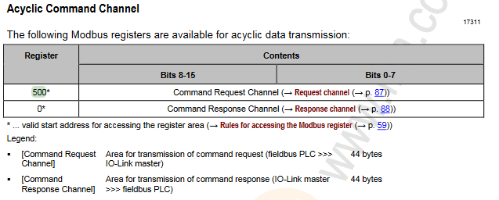
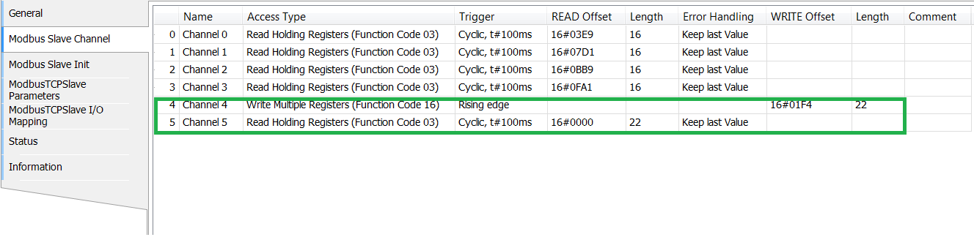
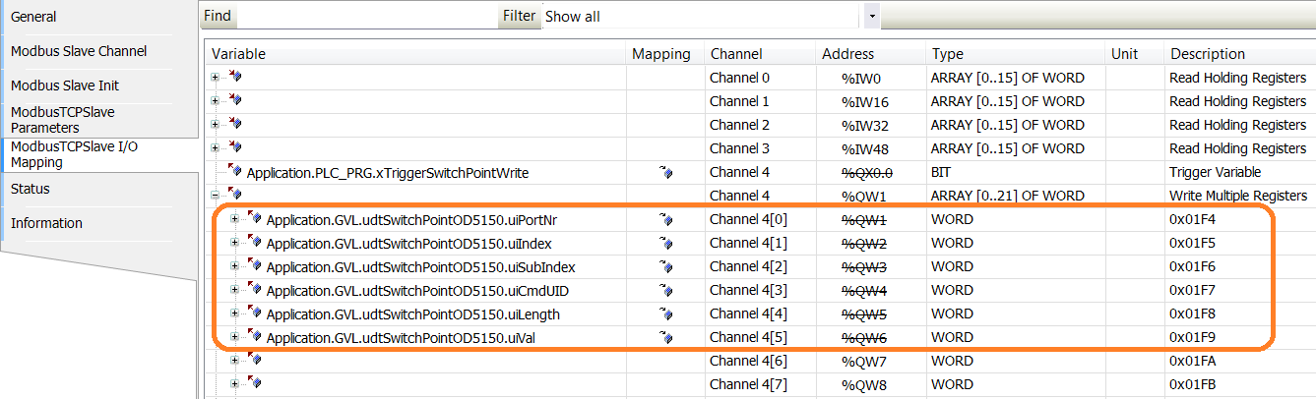
AL1x4x Setup PLC for reading or writing IO-Link parameters
Based on the process data project we add two Modbus Channels. One for sending a request on Register 500 and a second one to read the response on Register 0. We want to change the switch point of the O5D150
1. Add Channel 4 Write Multiple Registers and Channel 5 Read Holding Registers
2. Add Command Structure to the Mapping Table of Modbus Channel 4

Slide 3
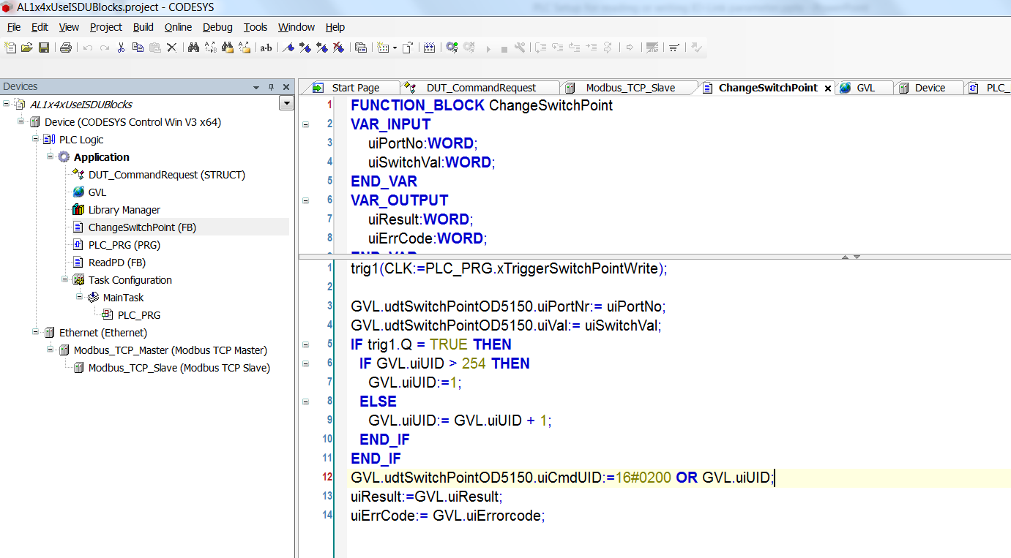
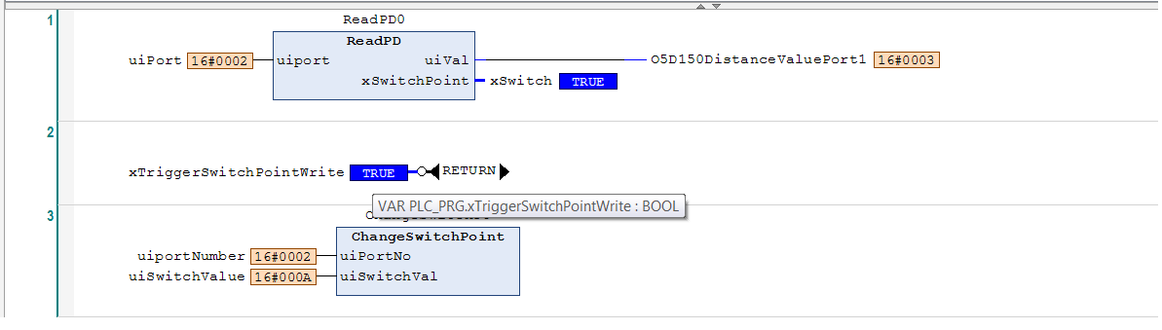
AL1x4x Setup PLC for reading or writing IO-Link parameters
3. Add a function block for the switch point and call it in PLC_PRG
4. Type in the IO-link port where the O5D150 is connected and type in an allowed value for the switch point.
Trigger the write process.

Slide 4
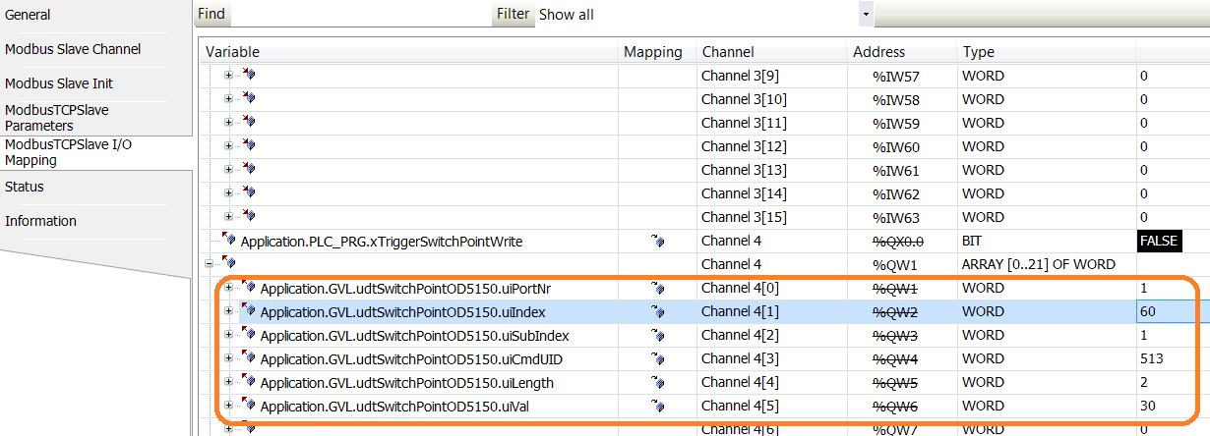
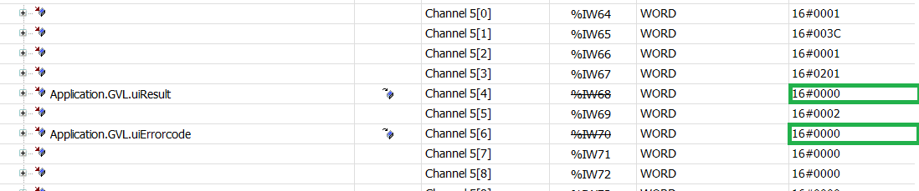
AL1x4x Setup PLC for reading or writing IO-Link parameters
5. Check the written values in Channel 4
6. Check the response on Channel 5

